Slide 1

Stage 8/Bay 7 X Factor Course Designer: Eric Beerbaum
X Factor is a 20 round, 100 point Comstock medium course. There are 10 USPSA targets. The best 2 hits per target will score. The start signal is audible.
The Handgun start position is feet touching either start stick. Handgun is loaded and holstered. PCC starting position feet touching either start stick. PCC loaded, safety on, stock touching belt.
On the audible start signal, engage all targets from within the shooting area.

Slide 2
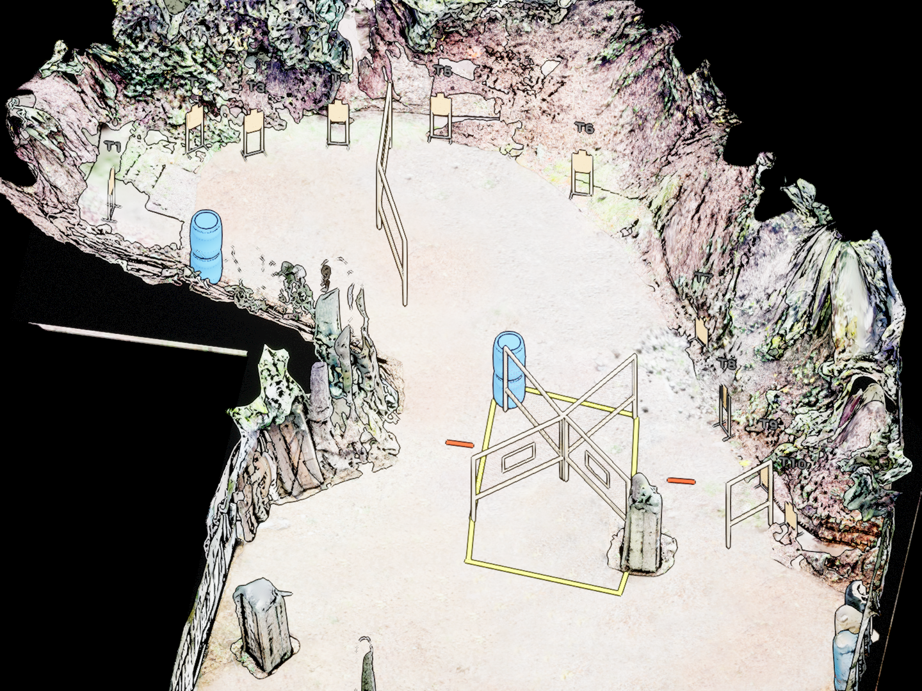
 | Stage 8/Bay 7 X Factor Course Designer: Eric Beerbaum

